Slide 1
Place double the number of bean bags in the second hoop.
www.cullyeducation.co.uk

Slide 2
Place double the number of bean bags in the second hoop.
www.cullyeducation.co.uk

Slide 3
Place double the number of bean bags in the second hoop.
www.cullyeducation.co.uk

Slide 4
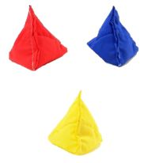
Place double the number of bean bags in the second hoop.
www.cullyeducation.co.uk

Slide 5
Place double the number of bean bags in the second hoop.
www.cullyeducation.co.uk

Slide 6
Place double the number of bean bags in the second hoop.
www.cullyeducation.co.uk

Slide 7
Place double the number of bean bags in the second hoop.
www.cullyeducation.co.uk

Slide 8
Place double the number of bean bags in the second hoop.
www.cullyeducation.co.uk

Slide 9
Place double the number of bean bags in the second hoop.
www.cullyeducation.co.uk

Slide 10
Place double the number of bean bags in the second hoop.
www.cullyeducation.co.uk

Slide 11
Place half the number of bean bags in the second hoop.
www.cullyeducation.co.uk

Slide 12
Place half the number of bean bags in the second hoop.
www.cullyeducation.co.uk

Slide 13
Place half the number of bean bags in the second hoop.
www.cullyeducation.co.uk

Slide 14
Place half the number of bean bags in the second hoop.
www.cullyeducation.co.uk

Slide 15
Place half the number of bean bags in the second hoop.
www.cullyeducation.co.uk

