Slide 1
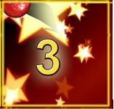
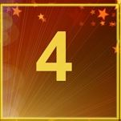
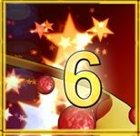
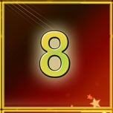
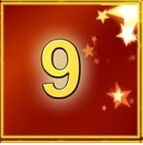
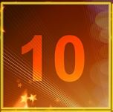
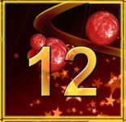
The 12 Scenes of Christmas
© 2016 www.cullyeducation.co.uk

Slide 2
12 Scenes of Christmas

Slide 3
12 Scenes of Christmas

Slide 4
12 Scenes of Christmas

Slide 5
12 Scenes of Christmas

Slide 6
12 Scenes of Christmas

Slide 7
12 Scenes of Christmas

Slide 8
12 Scenes of Christmas

Slide 9
12 Scenes of Christmas

Slide 10
12 Scenes of Christmas

Slide 11
12 Scenes of Christmas

Slide 12
12 Scenes of Christmas

Slide 13
12 Scenes of Christmas

